Slide 1
Predictive Regression Analysis for Sustainable Air Management
By Sanjit Cyrus R

Slide 2
ABSTRACT
The importance of Machine Learning in predicting Air Quality Index (AQI) is increasing day by day. This aids in informed health protection decisions amid air pollution's impacts. The factors that affect air quality and the machine learning model parameters that yield good prediction accuracy are not well covered in the existing literature. This study provides a comprehensive comparison analysis that estimates air quality using multiple regression models. To forecast the Air Quality Index, we utilize data from two distinct places in Chennai City. Manali, an industrial area, and Velachery, a residential suburb, are the two. For the purpose of assisting us or the government authorities in making decisions, the study also focuses on the factors that influence air quality. The main goal is to determine which model performs best by evaluating a variety of factors, including R2 measurements and Mean Absolute Error.

Slide 3
INTRODUCTION
In addressing the challenges posed by extensive air quality monitoring data, the concept of an Air Quality Index (AQI) emerges as a crucial tool. While technological progress has resulted in significant data generation, the sheer volume can overwhelm decision-makers and the public. Describing air quality becomes intricate with numerous sampling stations and parameters, leading to confusion even within scientific communities. Raw data and complex analyses may not engage the public effectively, especially when dealing with pollution-induced health issues. Developed countries have successfully utilized AQI for over three decades, transforming diverse air pollution parameters into a singular or multiple numerical representation. However, in India, limited efforts and a lack of public awareness about air pollution hinder AQI development. The imperative now is to create an efficient and comprehensible AQI scale, ensuring informed decision-making by citizens and policymakers to mitigate the impact of air pollution on health.

Slide 4
PROPOSED METHODOLOGY
Data Selection and Preprocessing
Calculation of AQI
Data analysis
Feature Selection
Ensemble - Model Building
Model parameter tuning and Results

Slide 5
DATA SELECTION & PREPROCESSING
The data used in this project has been sourced from the Central Pollution Control Board (CPCB). It is available in Kaggle.
It has AQI station wise data from 2018 – 2023 on an hourly basis.
It has the following columns From Date, To Date, PM2.5 (ug/m3), PM10 (ug/m3), NO (ug/m3), NO2 (ug/m3), NOx (ppb), NH3 (ug/m3), SO2 (ug/m3), CO (mg/m3), Ozone (ug/m3), Benzene (ug/m3), Toluene (ug/m3), Eth-Benzene (ug/m3), MP-Xylene (ug/m3), O Xylene (ug/m3) Temp (degree C), RH (%), WD (deg), SR (W/mt2), BP (mmHg), VWS (m/s)
The data used for prediction is of two areas in Chennai. One is Manali (Industrial area) and the other is Velachery (Residential area). Used two dataframes one for each area Each data frame has data on an hourly basis from 1-Jan-2018 to 31-Mar-2023.
Each data frame has more than 45000 records and the number of columns is 22.
In order to fill in the missing values the mean of values 5 days before and after the date of the same hour is calculated and filled. If there is any null value then it ignores the null value and calculates the value

Slide 6
CALCULATION OF AQI
Calculation of rolling averages
Calculation of Sub indices
Aggregation of sub indices to find AQI
Calculation of Rolling Averages
As per CPCB norms for calculation of AQI, first rolling averages and maximums need to be taken. The hours of rolling average needed is mentioned in the below table
Pollutants (ug/m3) | SO2 | NO2 | PM2.5 | PM10 | O3 | CO (mg/m3) | Pb | NH3
Averaging time | 24 | 24 | 24 | 24 | 8 | 8 | 24 | 24

Slide 7
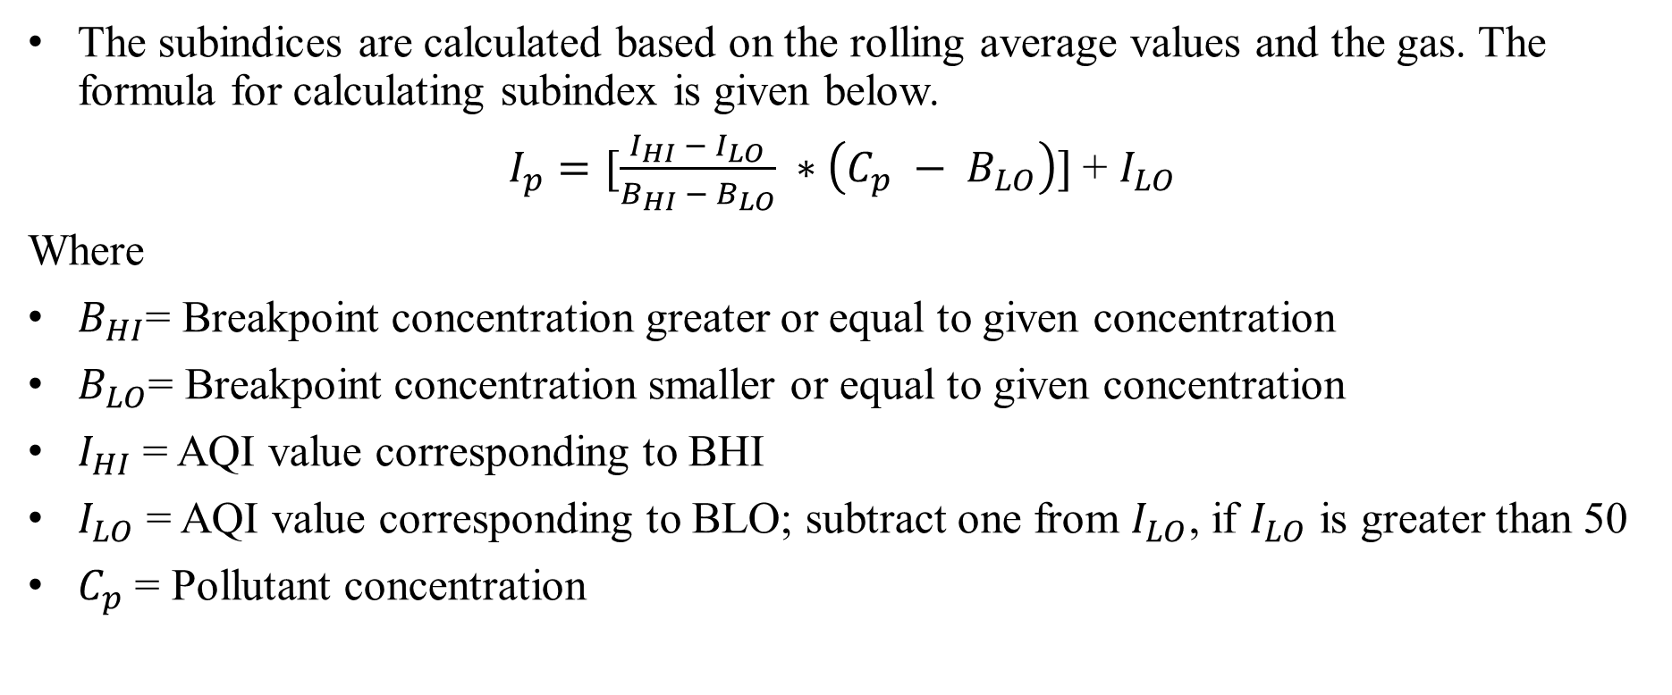
CALCULATION OF AQI
Calculation of Sub indices
The subindices are calculated based on the rolling average values and the gas. The formula for calculating subindex is given below.
$I_{p}=[\frac{I_{HI} − I_{LO}}{B_{HI} − B_{LO}} ∗\left(C_{p} − B_{LO}\right)]$+ $I_{LO}$
Where
$B_{HI}$= Breakpoint concentration greater or equal to given concentration
$B_{LO}$= Breakpoint concentration smaller or equal to given concentration
$I_{HI}$ = AQI value corresponding to BHI
$I_{LO}$ = AQI value corresponding to BLO; subtract one from $I_{LO}$, if $I_{LO}$ is greater than 50
$C_{p}$ = Pollutant concentration

Slide 8
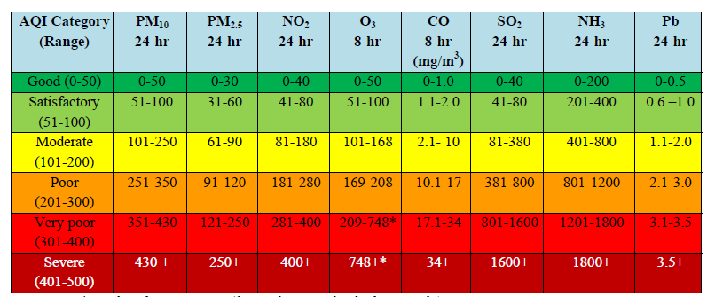
CALCULATION OF AQI
Calculation of Sub indices
The below table illustrates the breaking point for AQI scale from 0 – 500

Slide 9

CALCULATION OF AQI
Calculation of Sub indices
$I_{p}=[\frac{I_{HI} − I_{LO}}{B_{HI} − B_{LO}} ∗\left(C_{p} − B_{LO}\right)]$+ $I_{LO}$
Let us assume for the pollutant concentration of PM2.5 is 50 ug/m3. Then the subindex will be calculated as follows.
$I_{p}=[\frac{100 −50}{60 −30} ∗\left(50 −30\right)]$+ 50
$I_{p}$ = 83.33
AQI Value
Break point Concentrations

Slide 10
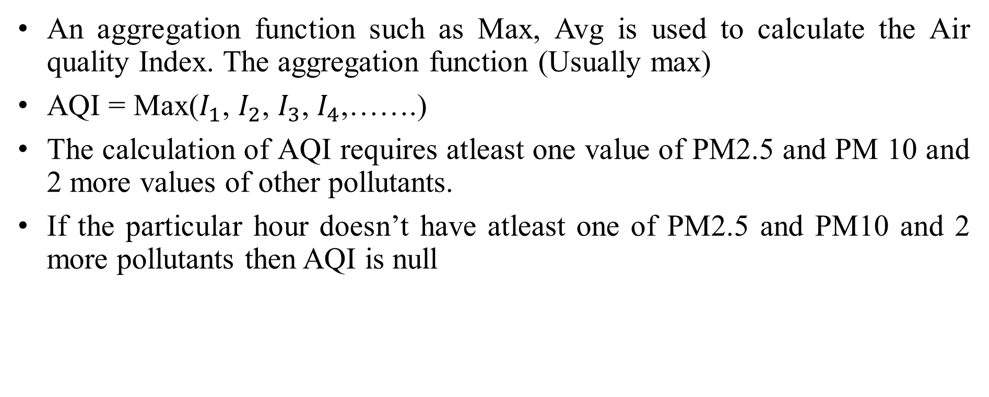
CALCULATION OF AQI
Aggregation of sub indices to find AQI
An aggregation function such as Max, Avg is used to calculate the Air quality Index. The aggregation function (Usually max)
AQI = Max($I_{1}$, $I_{2}$, $I_{3}$, $I_{4}$,…….)
The calculation of AQI requires atleast one value of PM2.5 and PM 10 and 2 more values of other pollutants.
If the particular hour doesn’t have atleast one of PM2.5 and PM10 and 2 more pollutants then AQI is null

Slide 11
DATA ANALYSIS
Different Aggregation of data is done using mean based on the following factors
Year
Month
Day
Hour
The results are explored in the upcoming slides for any insights

Slide 12
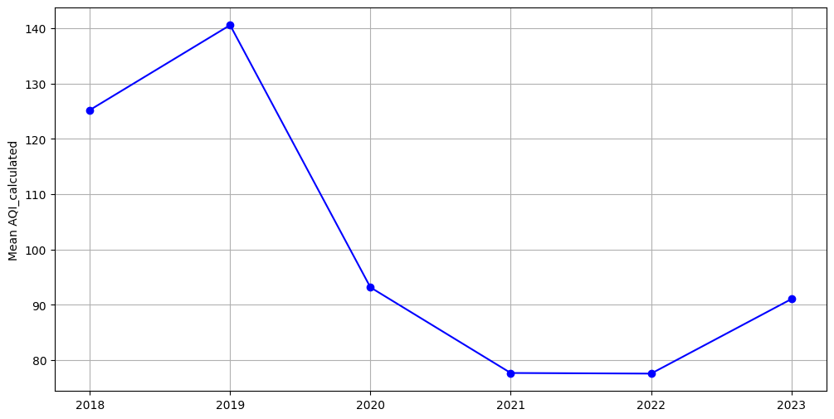
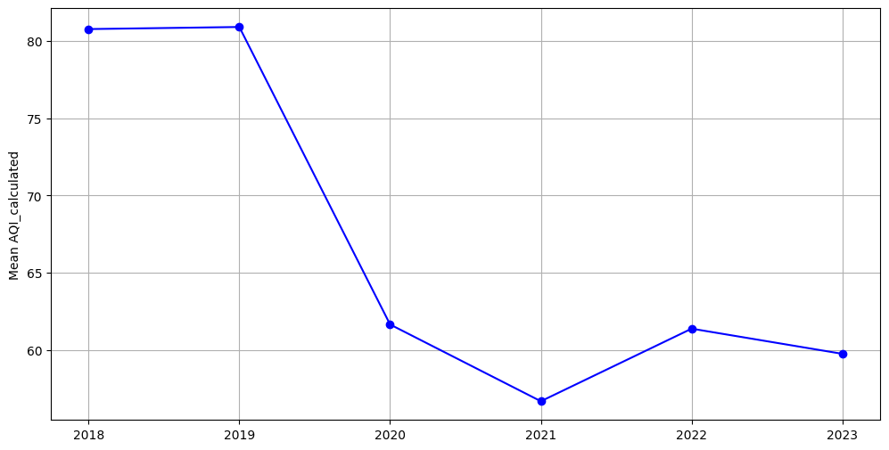
DATA ANALYSIS
Aggregation on basis of year
This is yearly Aggregate of manali AQI.
This shows a drastic drop from 2019 to 2020.
So yearly based Features influence the Air quality Index
This is yearly Aggregate of Velachery AQI.
This shows a drastic drop from 2019 to 2020.
So yearly based Features influence the Air quality Index

Slide 13
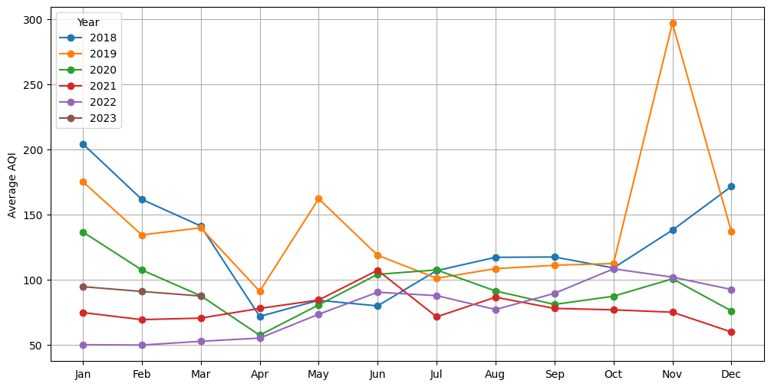
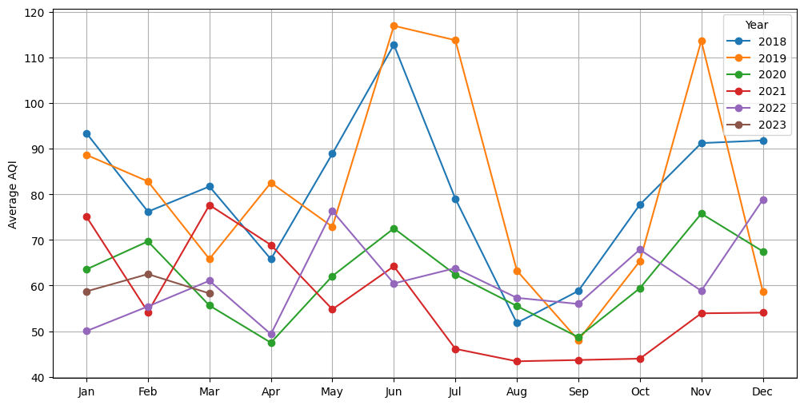
DATA ANALYSIS
Aggregation on basis of Month
This is monthly Aggregate of Manali AQI on a yearly basis.
The AQI seems to be more in months like Oct, Nov, Dec and less in other months
Monthly based Features influence the Air quality Index
This is yearly Aggregate of Velachery AQI on a yearly basis.
The AQI seems to be more in months like Apr - Jun and also Oct, Nov, Dec and less in other months
Monthly based Features influence the Air quality Index

Slide 14
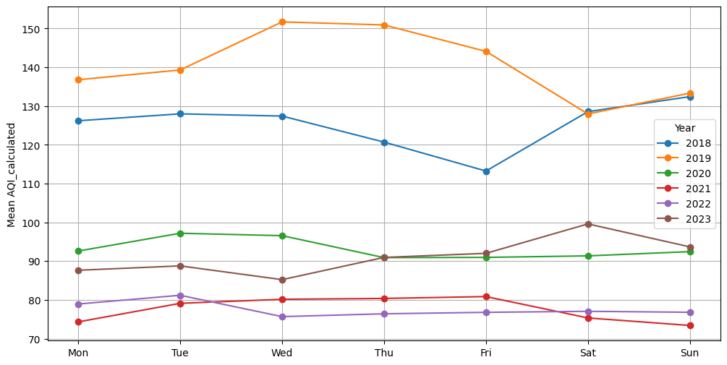
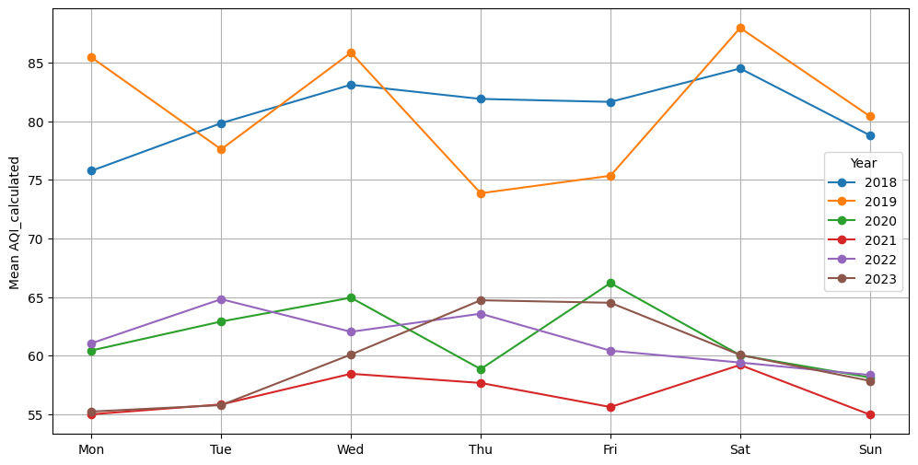
DATA ANALYSIS
Aggregation on basis of day
This is Aggregate of Manali AQI on a day of the week basis.
Except 2018 the AQI (Manali) in weekdays seem to be higher.
Day based Features influence the Air quality Index
This is Aggregate of Velachery AQI on a day of the week basis
The AQI pattern of velachery seems to be irregular
Day based Features will loosely influence the Air quality Index

Slide 15
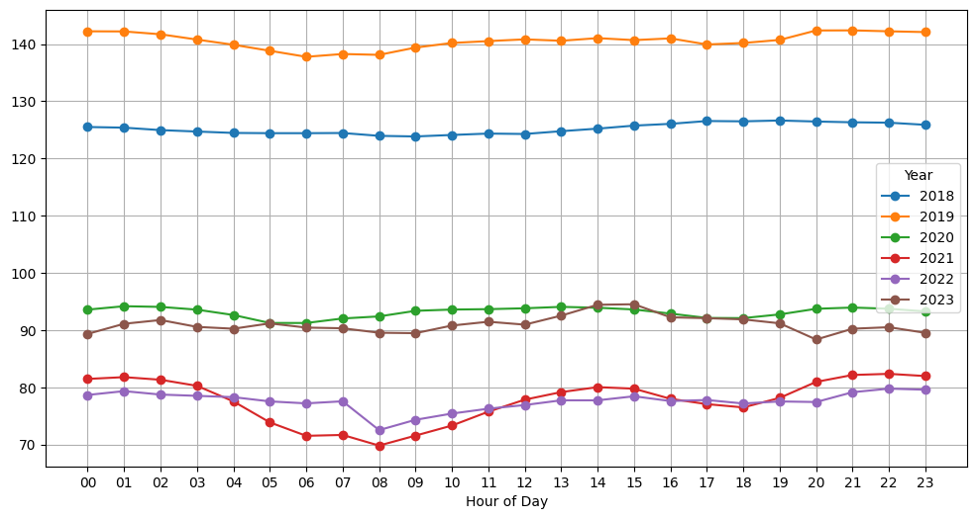
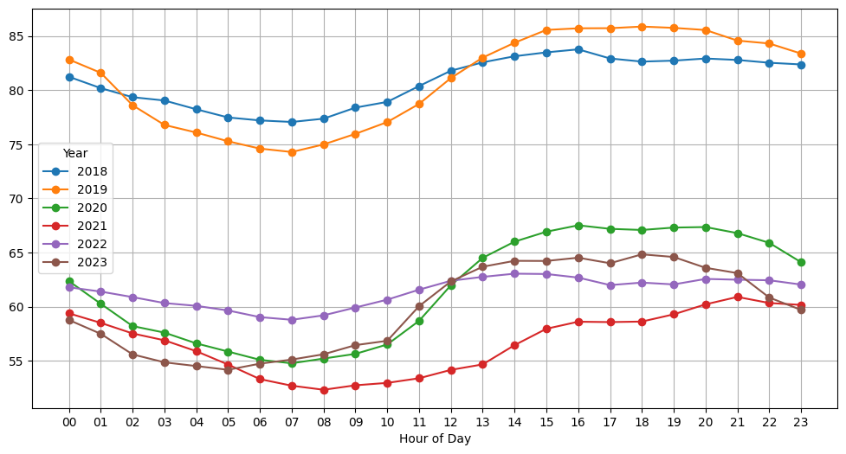
DATA ANALYSIS
Aggregation on basis of hour
This is hour of the day Aggregate of Manali AQI on a yearly basis.
In years 2018, 2019, 2023 the AQI is high after 12 noon. In other years it is b/w 22:00 and 02:00 hrs
Hour based Features influence the Air quality Index
This is hour of the day Aggregate of Velachery AQI on a yearly basis.
In all years the AQI is high after 12 noon. The max AQI is in between 17:00 and 22:00 hrs
Hour based Features influence the Air quality Index

Slide 16
FEATURE SELECTION
Numerical Variables
Category | Manali_AQI | Velachery_AQI
Pollution based | PM2.5 (ug/m³), NO (ug/m³), NO₂ (ug/m³), NO_{x} (ppb), NH3 (ug/m³), SO2 (ug/m³), CO (mg/m³) | PM2.5 (ug/m³), NO (ug/m³), NO₂ (ug/m³), NO_{x} (ppb), SO2 (ug/m³), CO (mg/m³), Ozone (ug/m³)
Weather Based | tempmax, tempmin, temp, feelslikemax, feelslikemin, feelslike, dew, humidity, precip, precipprob, precipcover, sealevelpressure, cloudcover, visibility, RH (%), WD (deg), SR (W/mt2), BP (mmHg), VWS (m/s), solarenergy, uvindex, moonphase

Slide 17
FEATURE SELECTION
Categorical Variables
Same categorical variables are used both in Manali and Velachery dataset as mentioned below.
Categorical Variable | IsBusinessDay | DayOfWeek | Month |  | Year | Conditions
Categories | True False | 0 1 2 3 4 5 6 | 1 2 3 4 5 6 | 7 8 9 10 11 12 | 2018 2019 2020 2021 2022 2023 | Partially cloudy Rain-Partially cloudy Rain-Overcast Clear Overcast

Slide 18
FEATURE SELECTION
The correlation coefficient is used to filter out the necessary variables to put into the model. The threshold set for correlation coefficient is 0.125.
Features of Manali_AQI | Correlation Coefficient
NH3 (ug/m3) | 0.18
NO (ug/m3) | 0.17
NO2 (ug/m3) | 0.16
NOx (ppb) | 0.14
PM2.5 (ug/m3) | 0.52
VWS (m/s) | 0.24
cloudcover | -0.15
dew | -0.23
feelslike | -0.17
feelslikemax | -0.16
feelslikemin | -0.16
sealevelpressure | 0.18
temp | -0.14
tempmin | -0.2
visibility | -0.14
Features of Velachery _AQI | Correlation Coefficient
CO (mg/m3) | 0.13
NO2 (ug/m3) | 0.15
Ozone (ug/m3) | 0.3
PM2.5 (ug/m3) | 0.47
VWS (m/s) | 0.24
cloudcover | -0.14
dew | -0.13
humidity | -0.16

Slide 19
ENSEMBLE – MODEL BUILDING
The following Regression Machine learning models are used for AQI prediction
Linear Regression
Ridge Regression
Lasso Regression
Elastic Net Regression
Decision Tree Regression
Random forest Regression
Gradient boost Regression
Ada Boost Regression
XGB Regression

Slide 20
ENSEMBLE – MODEL BUILDING
The Results are tabulated below. The data is split into 80 % training data and 20 % Testing data
Manali_AQI
Model | MAE | RMSE | R²
Linear Regression | 31.78 | 45.47 | 0.434
Ridge | 31.78 | 45.47 | 0.434
Lasso | 32.28 | 46.24 | 0.415
Elastic Net | 32.62 | 47.22 | 0.39
Decision Tree Regressor | 15.30 | 30.52 | 0.745
Random Forest Regressor | 13.10 | 22.51 | 0.861
Gradient Boosting Regressor | 24.39 | 36.44 | 0.637
Ada Boost Regressor | 58.83 | 64.62 | -0.143
XGB Regressor | 15.02 | 22.64 | 0.860
Velachery_AQI
Model | MAE | RMSE | R²
Linear Regression | 16.12 | 29.81 | 0.352
Ridge | 16.12 | 29.81 | 0.352
Lasso | 16.1 | 30.09 | 0.34
Elastic Net | 16.54 | 30.7 | 0.313
Decision Tree Regressor | 10.45 | 25.57 | 0.523
Random Forest Regressor | 8.67 | 18.06 | 0.762
Gradient Boosting Regressor | 13.47 | 25.01 | 0.544
Ada Boost Regressor | 32.09 | 40.09 | -0.142
XGB Regressor | 9.52 | 16.88 | 0.792

Slide 21
ENSEMBLE – MODEL BUILDING
We use kfold cross validation with folds as 5 to train the models using training dataset.
Average results for Manali_AQI training data
Model | MAE | RMSE | R²
Linear Regression | 31.39 | 44.34 | 0.435
Ridge | 31.38 | 44.34 | 0.435
Lasso | 31.78 | 45.03 | 0.418
Elastic Net | 32.07 | 45.99 | 0.392
Decision Tree Regressor | 16.46 | 32.17 | 0.703
Random Forest Regressor | 13.78 | 23.04 | 0.847
Gradient Boosting Regressor | 24.43 | 36.03 | 0.627
Ada Boost Regressor | 48.16 | 56.78 | 0.060
XGB Regressor | 15.22 | 22.64 | 0.853
Manali_AQI testing data
Model | MAE | RMSE | R²
Linear Regression | 31.78 | 45.47 | 0.434
Ridge | 31.78 | 45.47 | 0.434
Lasso | 32.28 | 46.24 | 0.415
Elastic Net | 32.06 | 45.99 | 0.392
Decision Tree Regressor | 16.44 | 32.08 | 0.703
Random Forest Regressor | 13.13 | 22.48 | 0.862
Gradient Boosting Regressor | 24.39 | 36.44 | 0.637
Ada Boost Regressor | 49.18 | 58.11 | 0.060
XGB Regressor | 15.02 | 22.64 | 0.860

Slide 22
ENSEMBLE – MODEL BUILDING
We use kfold cross validation with folds as 5 to train the models using training dataset.
Average results for Velachery_AQI training data
Model | MAE | RMSE | R²
Linear Regression | 16.26 | 30.06 | 0.351
Ridge | 16.25 | 30.06 | 0.351
Lasso | 16.2 | 30.34 | 0.339
Elastic Net | 16.69 | 30.84 | 0.317
Decision Tree Regressor | 11.44 | 27.77 | 0.445
Random Forest Regressor | 9.28 | 19.09 | 0.738
Gradient Boosting Regressor | 13.64 | 25.31 | 0.54
Ada Boost Regressor | 25.27 | 34.08 | 0.16
XGB Regressor | 9.66 | 17.1 | 0.79
Velachery_AQI testing data
Model | MAE | RMSE | R²
Linear Regression | 16.12 | 29.81 | 0.352
Ridge | 16.12 | 29.81 | 0.352
Lasso | 16.1 | 30.09 | 0.34
Elastic Net | 16.54 | 30.7 | 0.313
Decision Tree Regressor | 10.56 | 26.28 | 0.496
Random Forest Regressor | 8.6 | 17.89 | 0.767
Gradient Boosting Regressor | 13.47 | 25.01 | 0.544
Ada Boost Regressor | 23.36 | 32.33 | 0.237
XGB Regressor | 9.52 | 16.88 | 0.792

Slide 23
MODEL PARAMETER TUNING & RESULTS
Manali AQI
Model | Best parameters | Metrics without Hyper parameter tuning | Metrics with Hyper parameter tuning
Random Forest regressor | Max. depth: None Min. samples per leaf : 1 Min. samples per split: 2 No. of estimators: 200 | R2 : 0.862 RMSE : 22.48 MAE : 13.13 | R2 : 0.862 RMSE : 22.50 MAE : 13.07
Decision Tree regressor | Max depth: 20 Min samples per leaf: 2 Min samples per split: 10 | R2 : 0.735 RMSE : 31.1 MAE:15.47 | R2 : 0.749 RMSE : 30.29 MAE: 16.70
XGBoost regressor | Learning rate: 0.1 Max depth: 9 No. of estimators: 400 | R2 : 0.860 RMSE : 22.64 MAE: 15.02 | R2 : 0.887 RMSE : 20.28 MAE : 12.31

Slide 24
MODEL PARAMETER TUNING & RESULTS
Velachery AQI
Model | Best parameters | Metrics without Hyper parameter tuning | Metrics with Hyper parameter tuning
Random Forest regressor | Max depth: None Min samples per leaf : 1 Min samples per split: 2 No. of estimators: 200 | R2 : 0.767 RMSE : 17.89 MAE: 8.60 | R2 : 0.764 RMSE : 17.98 MAE : 8.61
Gradient Boost regressor | Learning rate: 0.1 Max depth: 7 Min samples per split: 2 No. of estimators: 300 | R2 : 0.544 RMSE : 25.01 MAE:13.47 | R2 : 0.812 RMSE : 16.03 MAE : 8.81
XGBoost regressor | Learning rate: 0.3 Max depth: 7 No. of estimators: 400 | R2 : 0.792 RMSE : 16.88 MAE:9.52 | R2 : 0.852 RMSE : 14.24 MAE: 7.63

Slide 25
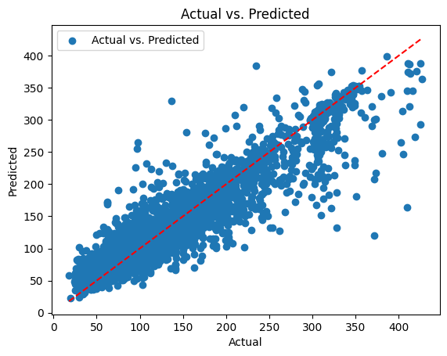
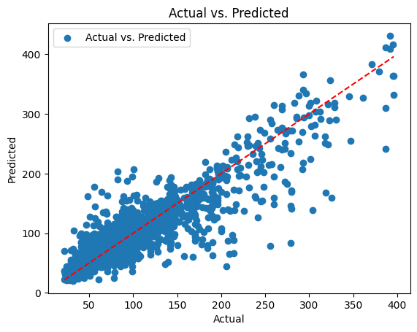
MODEL PARAMETER TUNING & RESULTS
Actual vs predicted graph for XGboost algorithm
Manali_AQI
Velachery_AQI

Slide 26
CONCLUSION
This project concludes by offering a comprehensive analysis of the fundamental characteristics necessary for precise forecasting of the Air Quality Index (AQI) and investigating diverse models for AQI prediction.
Both Weather based features and pollution based features influence the air quality significantly.
After a through examination, it was discovered that XGBoost performs better than other models, having R2, RMSE and MAE of 0.878, 21.08 and 12.87 respectively for Manali area and R2, RMSE and MAE of 0.838, 14.91, and 7.98 respectively for Velachery area.

